Slide 1


Christian Prasetya

Slide 2

Outline
Executive Summary
Introduction
Methodology
Results
Conclusion
Appendix

Slide 3
Executive Summary
Summary of methodologies
Data Collection
Data Wrangling
EDA with Data Visualization
EDA with SQL
Interactive Map with Folium
Dashboard with Ploty Dash
Predictive Analysis
Summary of all results
EDA results, Interactive analytics demo, and predictive analysis results.

Slide 4
Introduction
Project background and context
We predict if the first stage will land successfully. We can also determine the cost of a launch to let us know about the cost savings compare to the other rocket providers. This information can be used if there is any providers want to bid SpaceX for launching rocket.
Problems you want to find answers
What kind of parameters that impact or influence the success rate of landing?
What kind of condition that SpaceX need to prepare to achieve the best result of success rocket landing?

Slide 5


Slide 6
Methodology
Executive Summary
Data collection methodology:
SpaceX Rest API & Web Scrapping from Wikipedia.
Perform data wrangling
Removing irrelevant values & One hot encoding data implementation.
Perform exploratory data analysis (EDA) using visualization and SQL
Perform interactive visual analytics using Folium and Plotly Dash
Perform predictive analysis using classification models
How to build, tune, evaluate classification models

Slide 7
Data Collection
Describe how data sets were collected.
You need to present your data collection process use key phrases and flowcharts
Notes:
link

Slide 8
Data Collection – SpaceX API
Getting Response from API
Converting Response to a .json file
Apply Custom Function to clean data
Assign List to Dictionary to DataFrame
A bit data filtering & exporting file.
Github Url
Formatting the data into DataFrame
Get SpaceX Rest API
Cleaning the data
Export result data in csv files
Notes:
link

Slide 9
Data Collection - Scraping
Getting Response from HTML
Creating BeautifulSoup Object
Finding Tables
Getting Column names
Dictionary & Appending data
Converting/Formatting data
Dataframe into csv files
Github Url
Extract data into beautiful soup
Get HTML Response from Wikipedia
Export result data in csv files
Converting & Formatting data
Notes:
link

Slide 10
Data Wrangling
EDA on SpaceX Dataset
Calculate #of launches at each site
Calculate # occurrence of mission outcome / orbit type
Exporting dataset
Calculate #of occurrence of each orbit
Labeling landing column
Measuring % success for every landing
Notes:
link

Slide 11
EDA with Data Visualization
Scatter Graphs
Flight Number vs Payload Mass
Flight Number vs Launch Site
Payload vs Launch Site
Orbit vs Flight Number
Payload vs Orbit Type
Orbit vs Payload Mass
Bar Graph
Mean vs Orbit
Line Graph
Success Rate vs Year
Github Url
Notes:
link

Slide 12
EDA with SQL
Displaying the names of the unique launch sites in the space mission
Displaying 5 records where launch sites begin with the string 'KSC’
Displaying the total payload mass carried by boosters launched by NASA (CRS)
Displaying average payload mass carried by booster version F9 v1.1
Listing the date where the successful landing outcome in drone ship was achieved.
Listing the names of the boosters which have success in ground pad and have payload mass greater than 4000 but less than 6000
Listing the total number of successful and failure mission outcomes
Listing the names of the booster_versions which have carried the maximum payload mass.
Listing the records which will display the month names, successful landing_outcomes in ground pad ,booster versions, launch_site for the months in year 2017
Ranking the count of successful landing_outcomes between the date 2010-06-04 and 2017-03-20 in descending order
Github Url
Notes:
link

Slide 13
Build an Interactive Map with Folium
Github Url
To visualize the Launch Data into an interactive map. We took the Latitude and Longitude Coordinates at each launch site and added a Circle Marker around each launch site with a label of the name of the launch site. We assigned the dataframe launch_outcomes(failures, successes) to classes 0 and 1 with Green and Red markers on the map in a MarkerCluster().
Notes:
Link

Slide 14
Build a Dashboard with Plotly Dash
The dashboard is built with Flask and Dash web framework.
Graphs - Pie Chart showing the total launches by a certain site/all sites.
Scatter Graph showing the relationship with Outcome and Payload Mass (Kg) for the different Booster Versions - It shows the relationship between two variables. - It is the best method to show you a non-linear pattern. - The range of data flow, i.e. maximum and minimum value, can be determined.
Github Url
Notes:
Link

Slide 15
Predictive Analysis (Classification)
Building Model
Load & Transform data
Split into training & test dataset
Evaluating Model
Check Accuracy of model
Confusion matrix
Improving Model
Feature Engineering
Algorithm Tuning
Decide ML Algorithm
GridSearchCV Configuration
Implement dataset into GridSearchCV Algorithm
Finding Best Performance Classification
Based on best accuracy score
Github Url
Notes:
Link

Slide 16
Results
Exploratory data analysis results
Interactive analytics demo in screenshots
Predictive analysis results

Slide 17


Slide 18
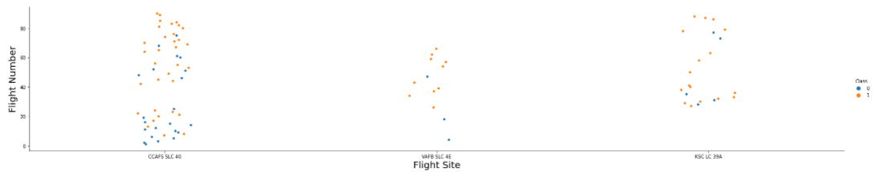
Flight Number vs. Launch Site
More amount of # flights at a launch site have inclination of greater the success rate at a launch site.

Slide 19
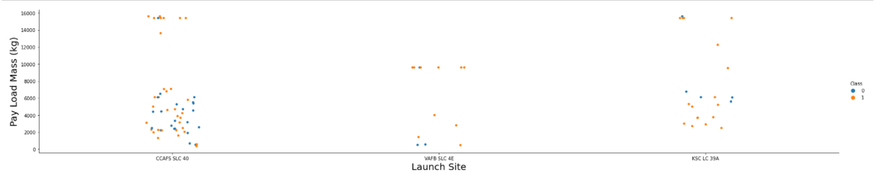
Payload vs. Launch Site
The greater the payload mass for CCAFS SLC 40, the higher the success rate for the Rocket.
For the VAFB-SLC launchsite there are no rockets launched for heavypayload mass(greater than 10,000)

Slide 20
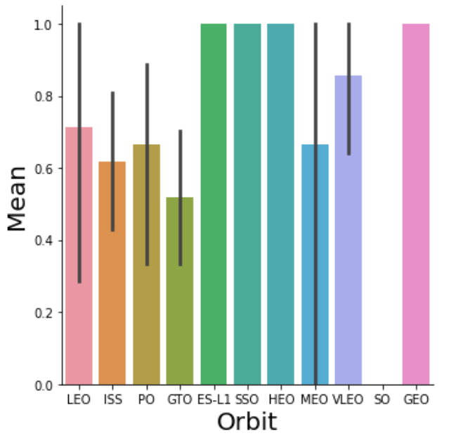
Success Rate vs. Orbit Type
The best success rates happened on
GEO
HEO
SSO
ES-L1

Slide 21
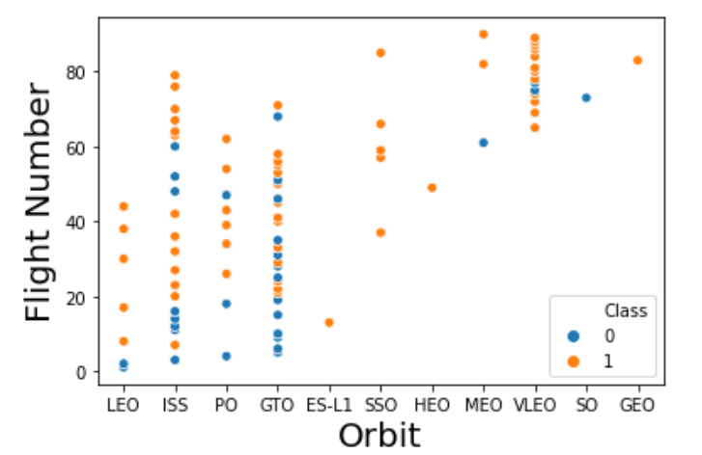
Flight Number vs. Orbit Type
On LEO Orbit, there are relations between # success appears and number of flights.
On the other hand, there is no relation in the other orbit.

Slide 22
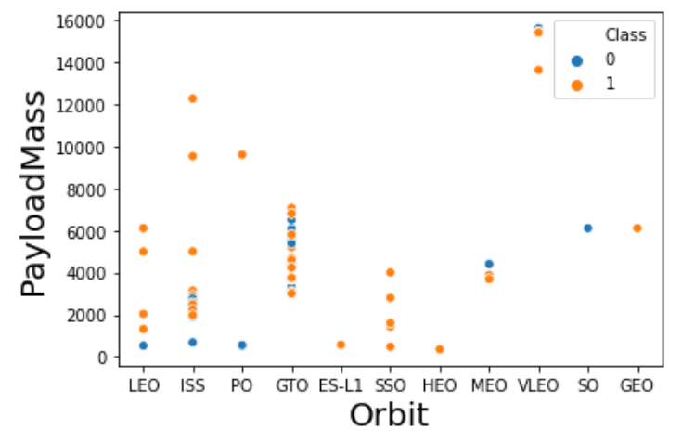
Payload vs. Orbit Type
With heavy payloads, the successful landing landing rate happened in LEO and ISS orbit.
However for GTO, we cannot distinguish this well as both positive landing and negative landing.

Slide 23
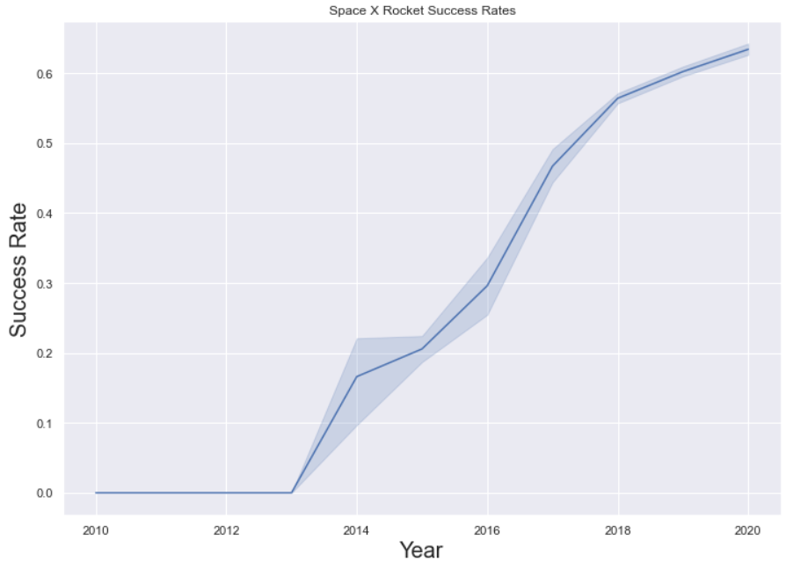
Launch Success Yearly Trend
Since 2013, the success rates start constantly increasing until 2000.

Slide 24
All Launch Site Names
select DISTINCT Launch_Site from tblSpaceX

Slide 25
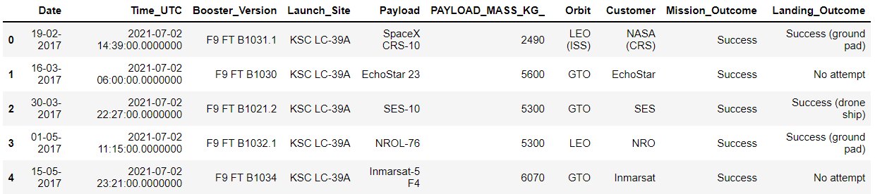
Launch Site Names Begin with KSC'
select TOP 5 * from tblSpaceX WHERE Launch_Site LIKE 'KSC%'

Slide 26
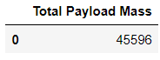
Total Payload Mass
select SUM(PAYLOAD_MASS_KG_) TotalPayloadMass from tblSpaceX where Customer = 'NASA (CRS)'

Slide 27
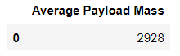
Average Payload Mass by F9 v1.1
select AVG(PAYLOAD_MASS_KG_) AveragePayloadMass from tblSpaceX where Booster_Version = 'F9 v1.1'

Slide 28
First Successful Ground Landing Date
select MIN(Date) SLO from tblSpaceX where Landing_Outcome = 'Success (drone ship)'

Slide 29
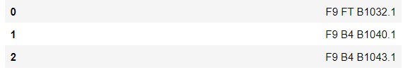
Successful Drone Ship Landing with Payload between 4000 and 6000
select Booster_Version from tblSpaceX where Landing_Outcome = 'Success (ground pad)' AND Payload_MASS_KG_ > 4000 AND Payload_MASS_KG_ < 6000

Slide 30
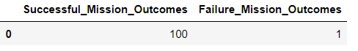
Total Number of Successful and Failure Mission Outcomes
SELECT(SELECT Count(Mission_Outcome) from tblSpaceX where Mission_Outcome LIKE '%Success%') as Successful_Mission_Outcomes,(SELECT Count(Mission_Outcome) from tblSpaceX where Mission_Outcome LIKE '%Failure%') as Failure_Mission_Outcomes

Slide 31
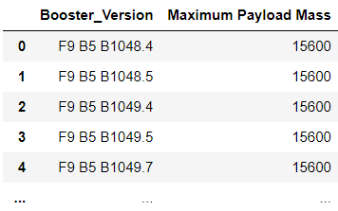
Boosters Carried Maximum Payload
SELECT DISTINCT Booster_Version, MAX(PAYLOAD_MASS_KG_) AS [Maximum Payload Mass] FROM tblSpaceX GROUP BY Booster_Version ORDER BY [Maximum Payload Mass] DESC

Slide 32
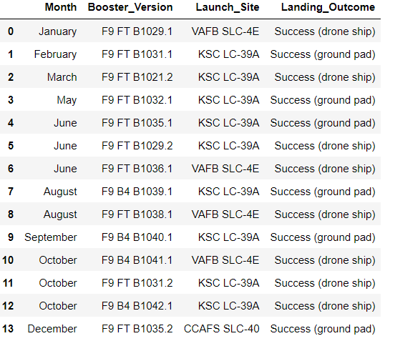
2015 Launch Records
SELECT DateName( month , DateAdd( month , MONTH(CONVERT(date,Date, 105)) , 0 ) - 1 ) as Month, Booster_Version, Launch_Site, Landing_Outcome FROM tblSpaceX WHERE (Landing_Outcome LIKE N'%Success%') AND YEAR(CONVERT(date,Date, 105)) = ‘2015'

Slide 33
Rank Landing Outcomes Between 2010-06-04 and 2017-03-20
SELECT COUNT(Landing_Outcome) AS sl FROM dbo.tblSpaceX WHERE (Landing_Outcome LIKE '%Success%') AND (Date >'04-06-2010') AND (Date < '20-03-2017')

Slide 34


Slide 35
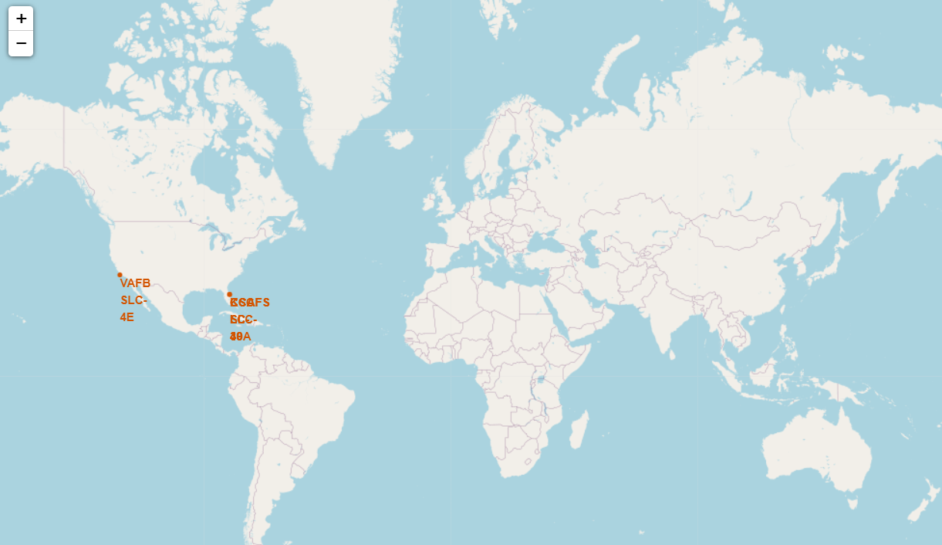
Launch Sites in Global Maps Perspective

Slide 36
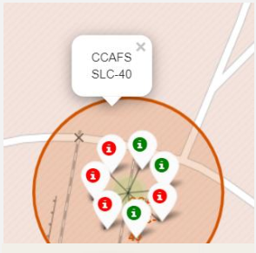
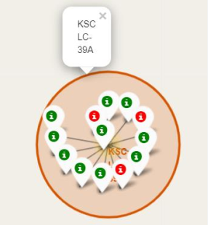
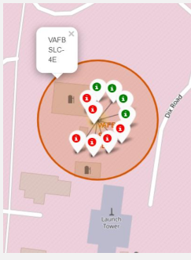
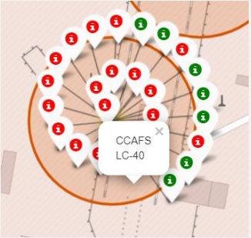
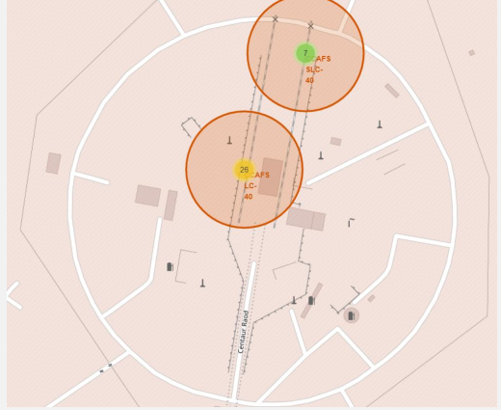
Labeling Markers
Florida Launch Sites
California Launch Sites

Slide 37
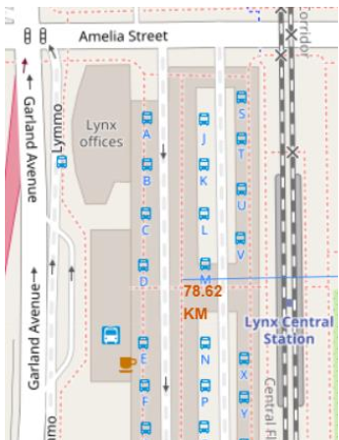
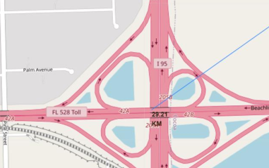
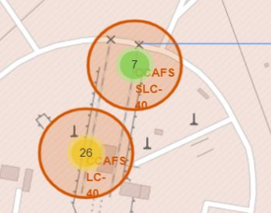
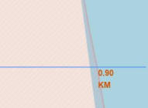
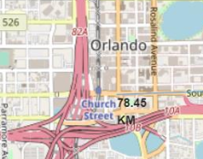
Launch sites close proximity to city ~ but far away from railways, highways, and city
Distance to Railway Station
Distance to Highway
Distance to Coast
Distance to Coastline
Distance to City

Slide 38


Slide 39
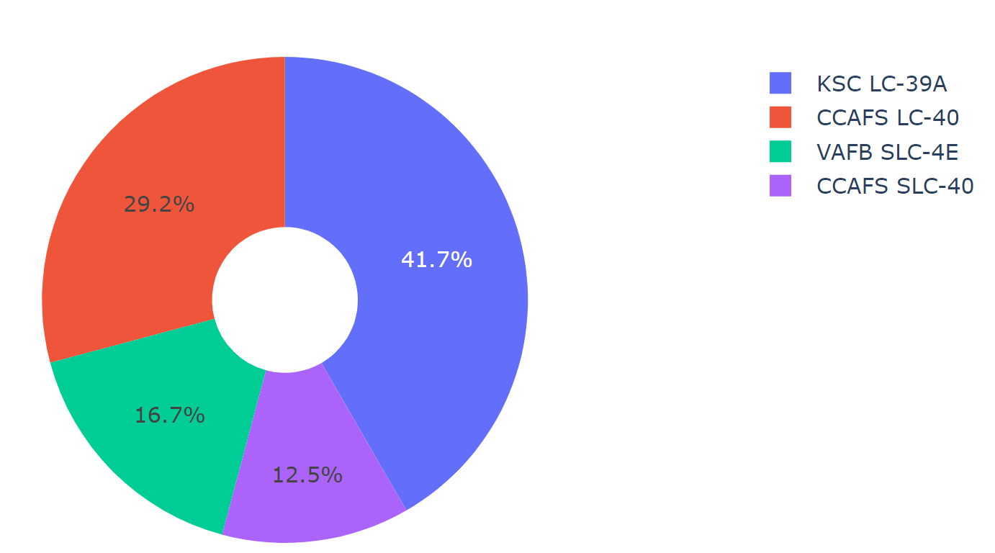
Total Success Launches by All Sites
KSC LC-39A have the most successful launches among all the sites

Slide 40
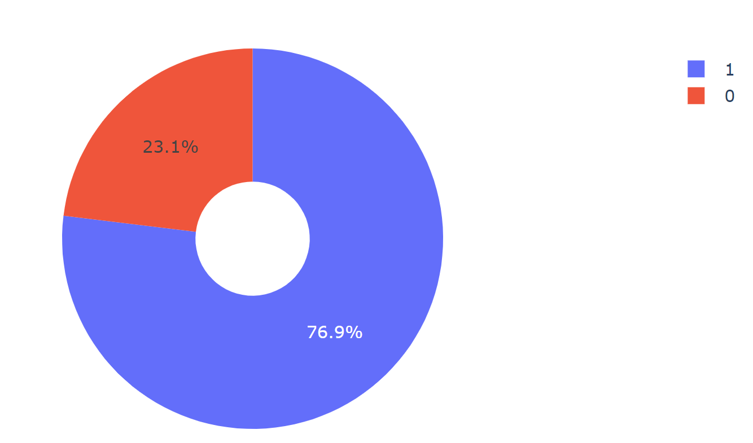
Highest Success Ratio of Launch Sites
KSC LC-39A 76.9% success rate
23.1% failure rate

Slide 41
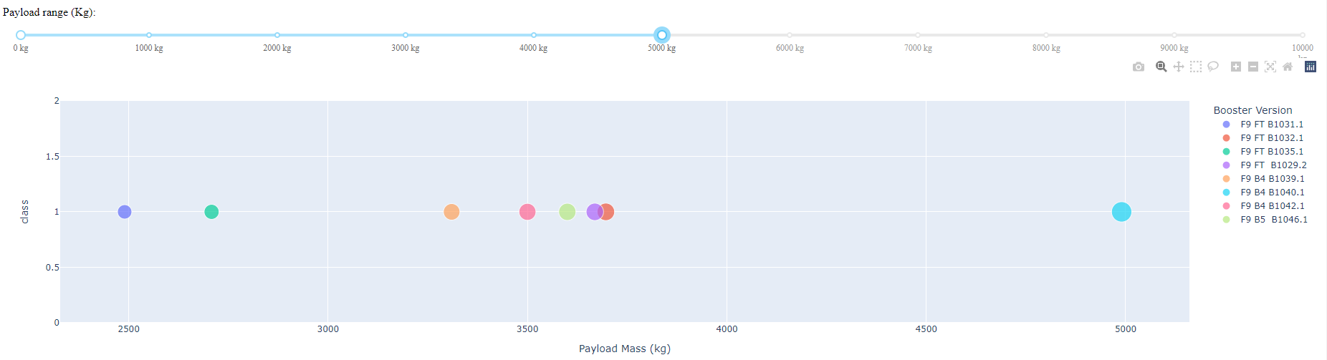
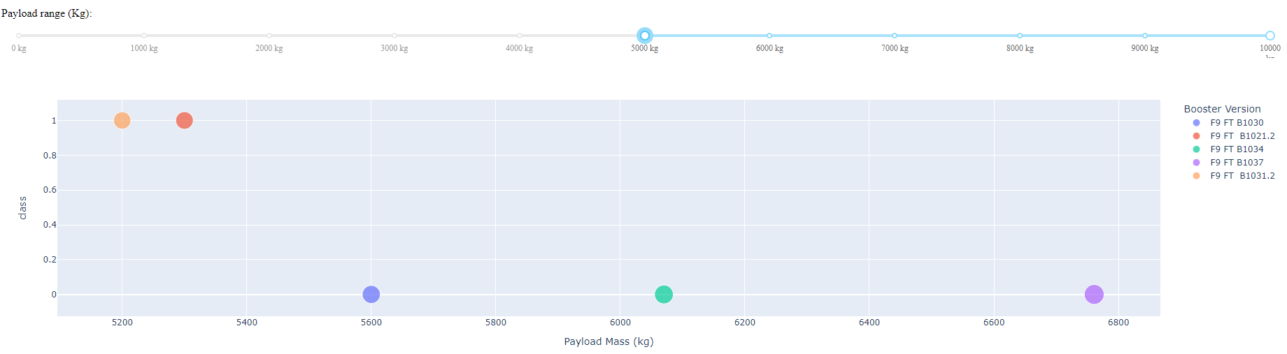
Payload vs Launch Outcome Plot with Weighted Category Slider
% Success of low weighted payloads (0-5.000 kg) is greater than % success of heavy weighted payloads (5.000-10000 kg)

Slide 42


Slide 43
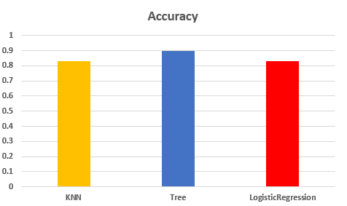
Classification Accuracy
Tree Algorithm have the highest accuracy among other algorithm, with 90% accuracy.

Slide 44
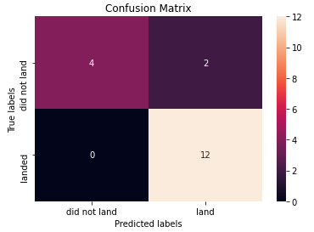
Confusion Matrix
Correct Prediction for all labels, except 2 datas for false positive case.

Slide 45
Conclusions
Tree algorithm is the best machine learning options to be implemented.
Low weighted payloads perform better than heavy payloads.
KSC LC-39A is the most successful launches over all the sites.
GEO, HEO, ES-L1, and SS0 are the best orbit’s success rate.

Slide 46
Appendix
Sql Server Module (ADGSQLSERVER)

Slide 47


